Slide 1



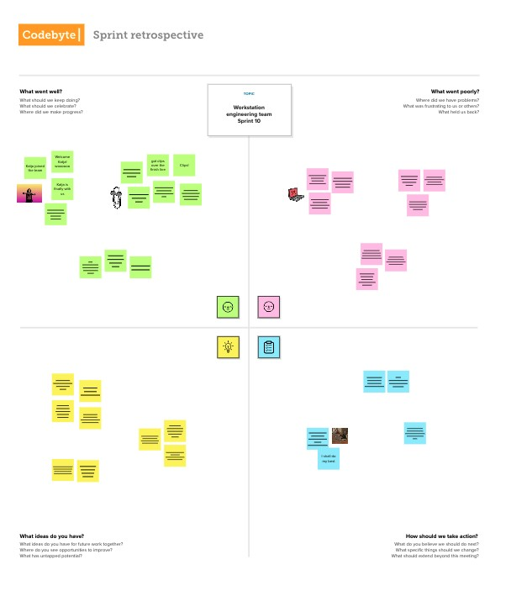



Template
✴
TEAM MEMBERS
1.Sharan R
2. Abishek Vino R
3. Nihal Shrivastav
4. Satish Kumar
5. Anand Kuma
Empathy Map
Type your paragraph...
What they Say?
How data analytics helps? what needs to be improved? what should be focussed?
TOPIC
What we feel?
What we Fear? What we are confident about?..
Data-Driven insights on Olympic Sports Participation and Performance
We need accurate and reliable data to improve athlete performance
We want to identify talented athletes early on and support their development.
Nervous about challenges of
Feeling motivated in discovering
Created in partnership with
The founder of the modern Olympics, Baron Pierre de Coubertin, once said: "The most important thing in the Olympic Games is not winning but taking part; the essential thing in life is not conquering but fighting well."
collecting, managing, and analyzing large amounts of data.
hidden patterns and trends that can drive improvements
Data analytics can help us prevent injuries and optimize recovery. We want to enhance fan engagement and create a better sports experience
positive that data- driven insights can lead to breakthroughs in athlete development and performance.
Utilize data to make data driven decisions on performance and participation improvement
Utilizes data to inform strategic decisions, athlete selection, and sponsorship opportunities, countries participation
Data Analysis can give a clear cut way to identify patterns and trends to optimize athlete performance and potential
Visualizations can help us understand better the areas of improvement, efficient performance, and lacking of participation so on....
Data cleaning can help us reduce the burden and make our analysis job easier
Share the data visualization with stakeholders and share our findings on the trends and decision or conclusion taken from the exploration of data
Share template feedback
How should we take action?
How we use our analysis? How we share our findings with stakeholders?
What we think?
How data analysis going to help in this work? How it leads to development?
What troublesome us?
Need some inspiration?
See a finished version of this template to kickstart your work.
Open example

